Slide 1

Dorm Management System
By
Dann
Madhusodan
Marc

Slide 2
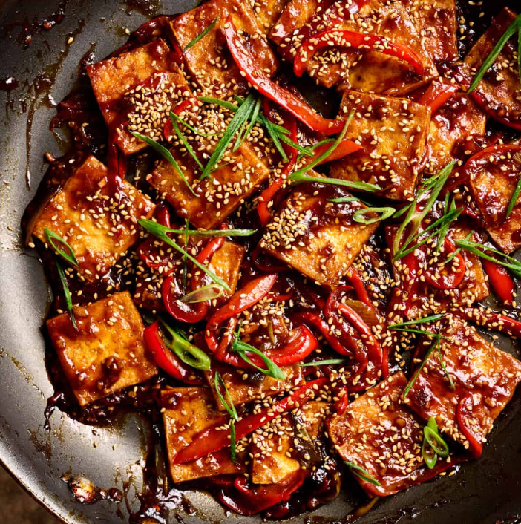
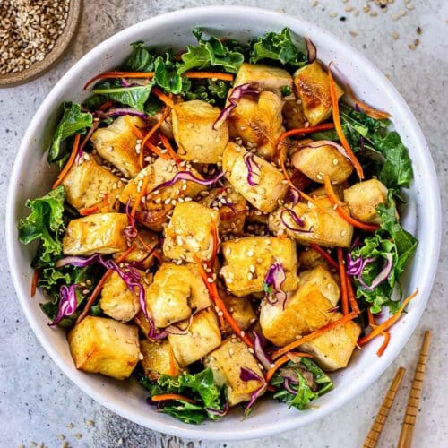

Who likes TOFU?

Slide 3
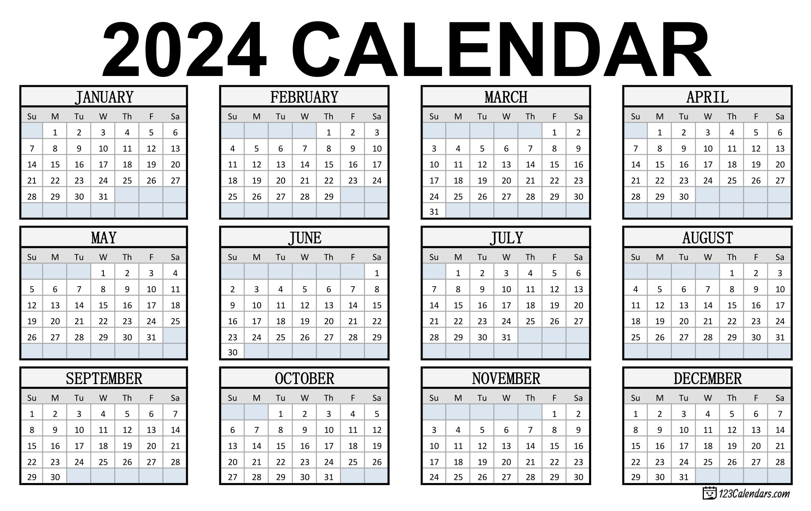

Slide 4
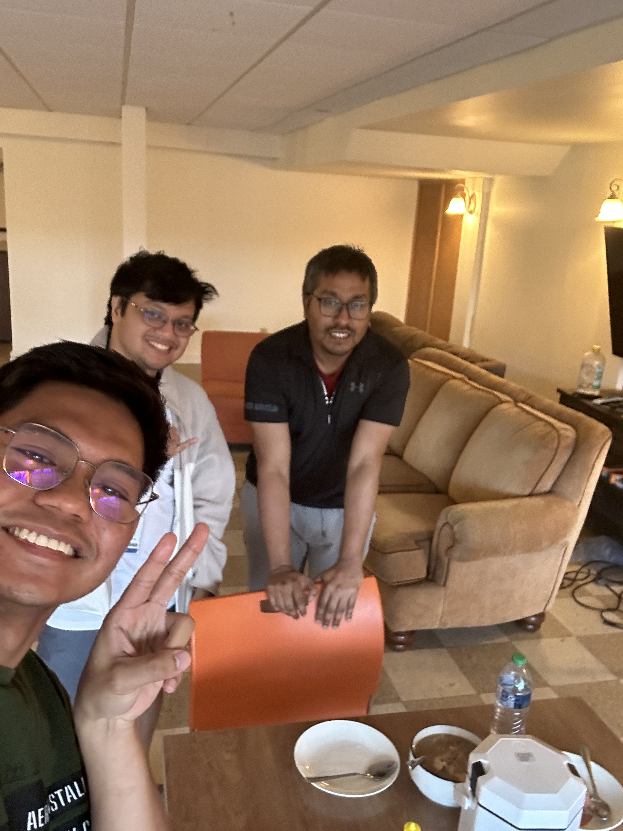
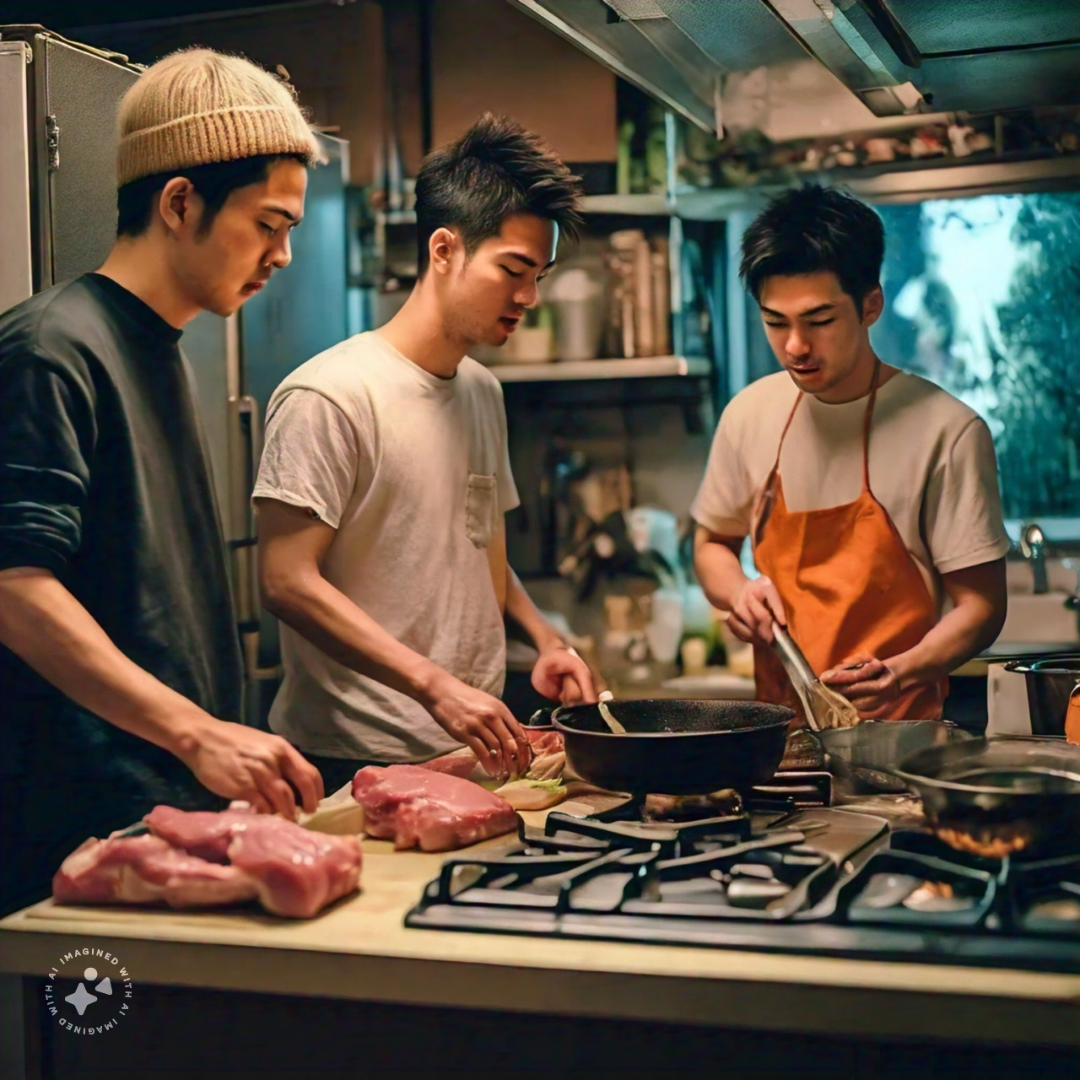
Kitchen is Life

Slide 5
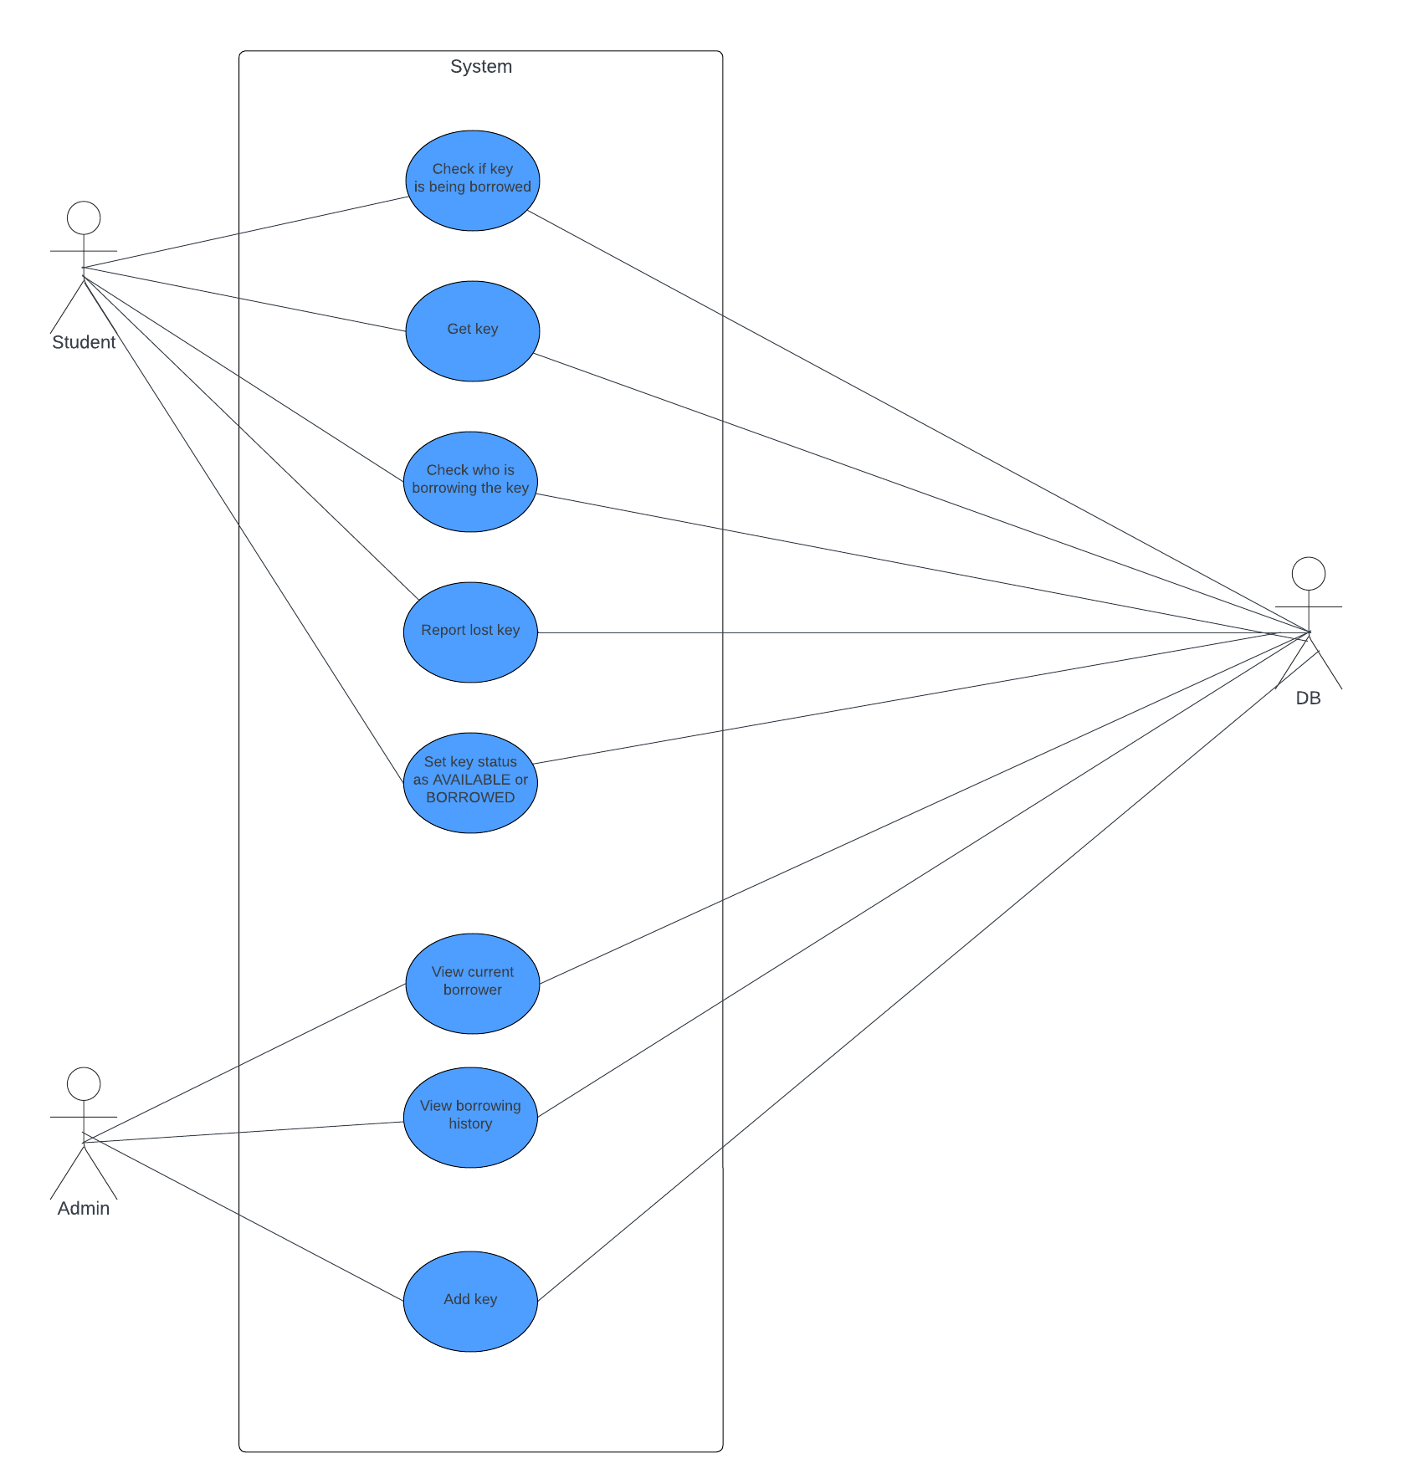
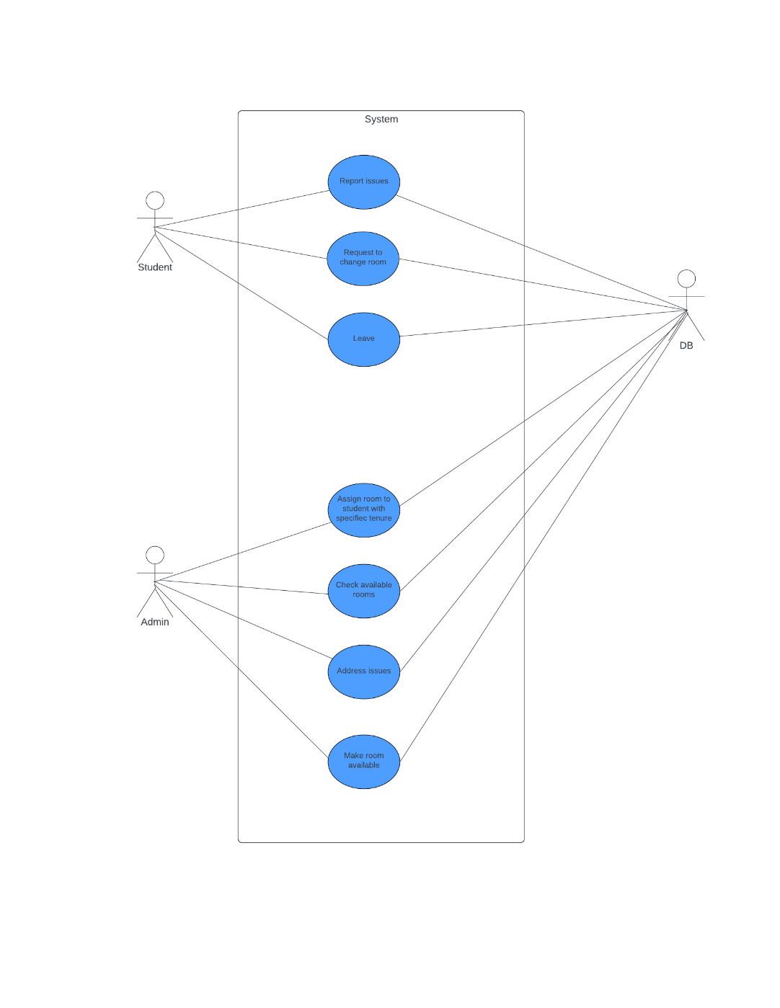
Kitchen Key Module
Rooms Module

Slide 6
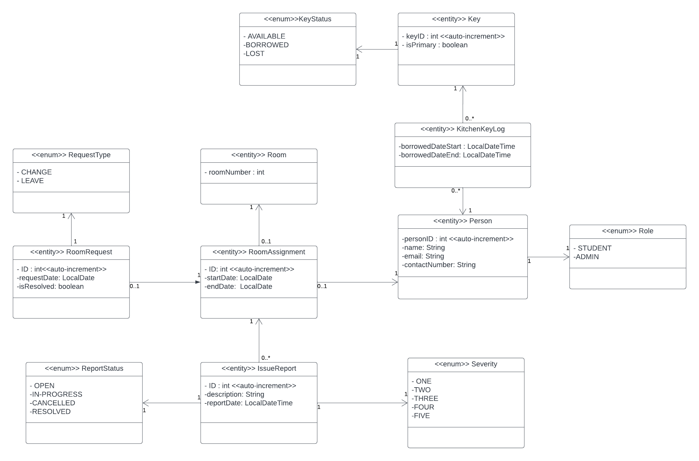
C L A S S D I A G R A M

Slide 7
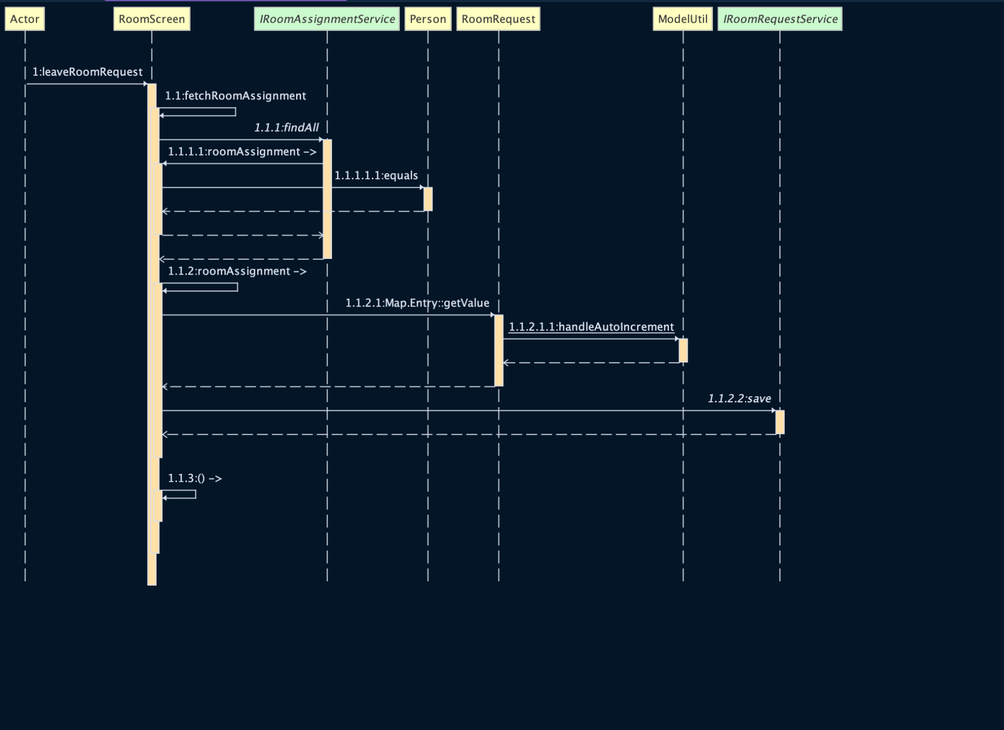
Leave Room Request Sequence Diagram

Slide 8
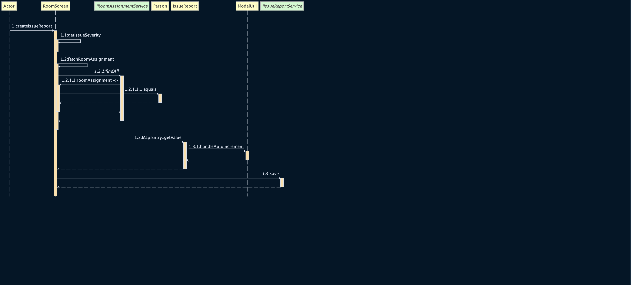
createIssueReport Sequence Diagram

Slide 9
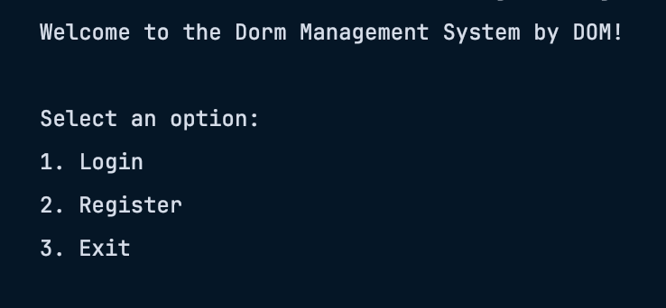
CODE DEMO

Slide 10
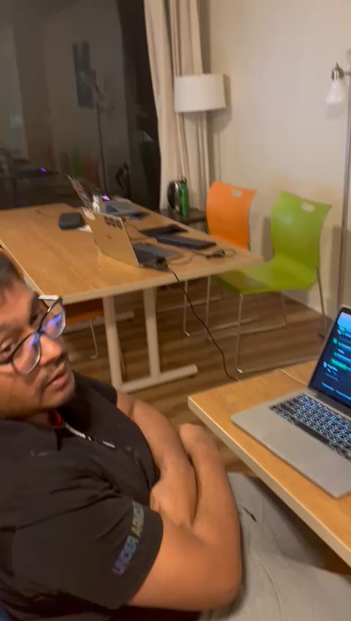
One Final Pull Request

